Slide 1

Cyclistic Case Study – Google Data Analytics Capstone
Converting Casual Riders to Members
Presented by: Francesco Marchì
Last updated: 25/07/2025

Slide 2
Agenda
Business Task & Hypothesis
Data Overview & Cleaning
Rider Behavior Insights
Cost & Pricing Analysis
Recommendations
Takeaways & Next Steps

Slide 3
Business task
Cyclistic wants to increase annual memberships
Hypothesis
Casual riders who frequently ride or overspend are strong conversion candidates

Slide 4
Dataset & Preparation
Sources: Q1 2019 and Q1 2020 Divvy bike-share data
~500,000 rows after cleaning
Removed test rides (HQ QR), outliers (>24h), and negative durations
Created new features: ride length, weekday, cost estimate

Slide 5
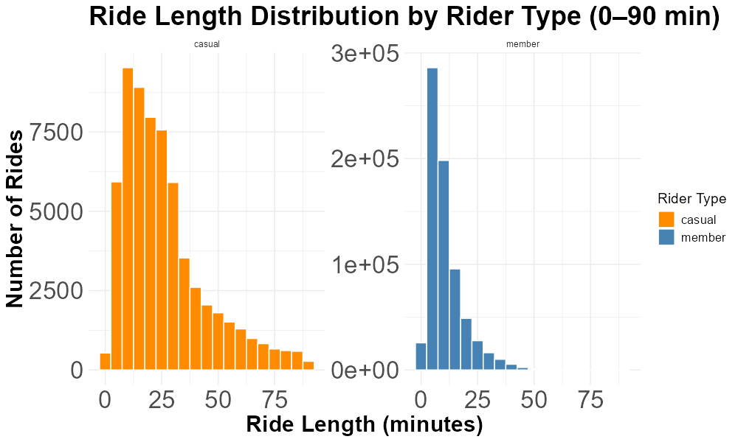
How Casual and Member Riders Behave
Notes:
“Let’s start by understanding how our two customer types behave. On the left, we see casual riders, their ride durations are widely spread, with a significant portion lasting over 30 minutes. On the right, member riders take much shorter trips, almost all under 20 minutes.
This contrast matters because ride length directly impacts cost for casuals, while members enjoy flat-rate pricing. So the longer the ride, the worse the deal for casual users.
This insight reveals a strategic leverage point: there’s a conversion segment of casuals whose ride behavior makes them ideal candidates for membership.
In the next slide, we’ll isolate and visualize this group: casual riders whose trips regularly exceed 45 minutes and therefore represent high conversion potential.”

Slide 6
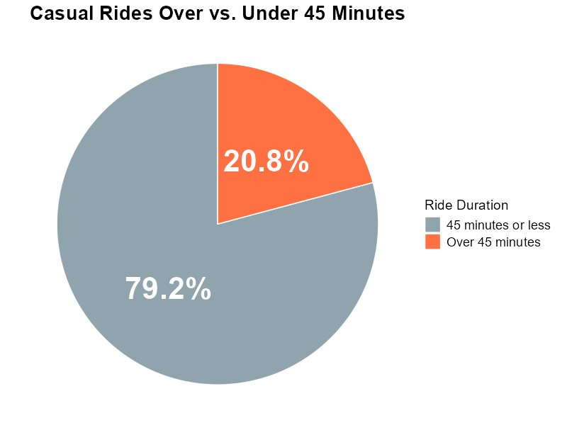
Riding Like Members, Paying Like Tourists
Notes:
“Here we isolate a segment of casual riders who behave like members, but pay like tourists.
These are users regularly taking rides over 45 minutes, which drives up their cost under the per-minute model.
As shown here, 20.8% of casual rides exceed 45 minutes. That’s not an outlier, it’s a clear behavioral pattern.
These riders are high-engagement users stuck in a pricing model that punishes them. That creates inefficiency for them, and opportunity for us.
This is our conversion segment: casuals who ride like members and stand to benefit most from switching.
Let’s look next at what they’re actually paying, and how strong the incentive to convert really is.”

Slide 7
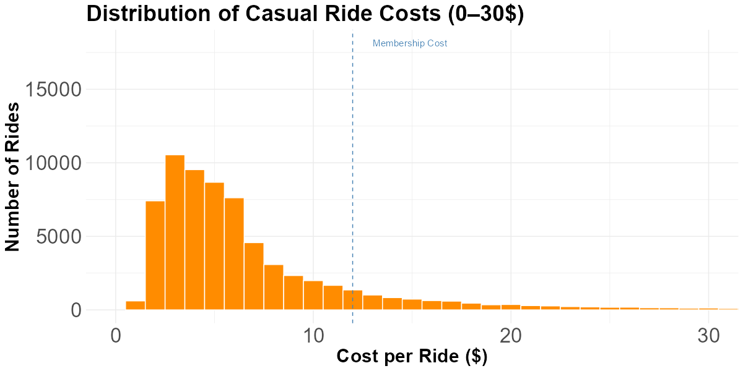
They’re Already Paying More
Many casual rides cost between $5 and $15
Large portion exceed $11.99 — the monthly membership cost
One long ride can cost more than an entire month of membership
Notes:
“Let’s look at how much casual users are actually paying.
This histogram shows the distribution of casual ride costs. You can see that many rides fall between $5 and $15.
That dashed line marks the monthly membership cost: $11.99.
What we’re seeing is significant: a large number of casual users are paying more than the monthly membership fee for just one ride.
That’s not sustainable, and it’s not good value for them.
This gives us strong leverage: we don’t need to persuade users on theory, the price gap is already telling the story.
They’re already paying more. They just don’t know it yet.”

Slide 8
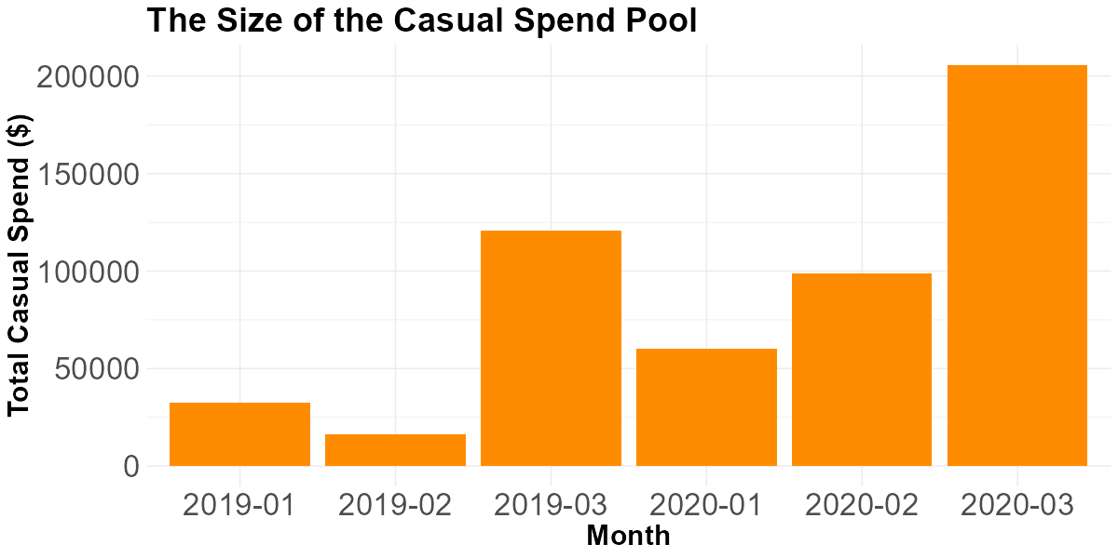
The Size of the Casual Spend Pool
Casual riders spend over $200K/month collectively
Monthly spend is consistent and rising
This shows how much value exists in the casual user base
Notes:
“We’ve seen what individual casuals are paying, but what does this look like at scale?
Let’s zoom out and see how big this pool really is.” “This chart shows how much casual riders are collectively spending each month.
What stands out is the scale, we’re looking at hundreds of thousands of dollars in per-ride payments from casual users, and the trend is growing.
This tells us the casual user base isn’t just active, it’s financially significant.
And this is exactly the group where we have strategic leverage: the spending is there, and the conversion potential is real.
It’s not a question of creating value, it’s about capturing it more efficiently.”

Slide 9
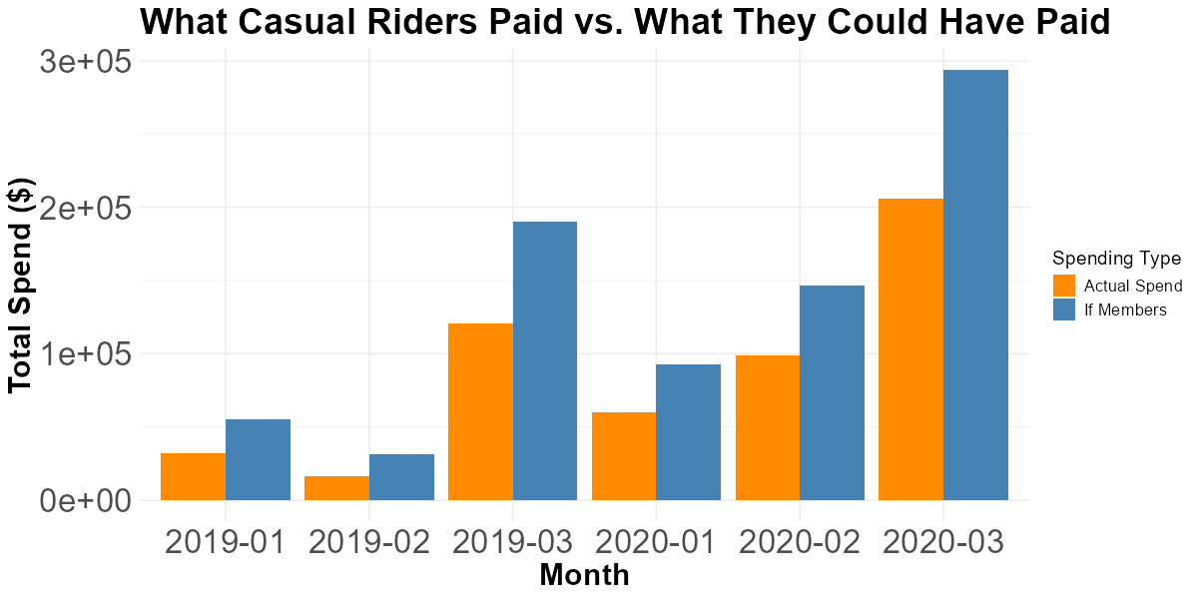
They are leaving money on the table
Casual riders often spend more than the $11.99 membership fee
Every month shows a gap between actual spend and potential spend
That gap = missed savings for users and lost recurring revenue for Cyclistic
Notes:
This chart compares actual casual rider spending to what they would have paid if they’d been members.
The blue bars represent the cost if all casual riders had subscribed to a monthly membership.
The orange bars show what they actually spent — often more.
The gap represents lost savings for riders — and missed recurring revenue for Cyclistic.
This highlights both the financial inefficiency for riders and the potential revenue stream for the company if more casual users converted to members.

Slide 10
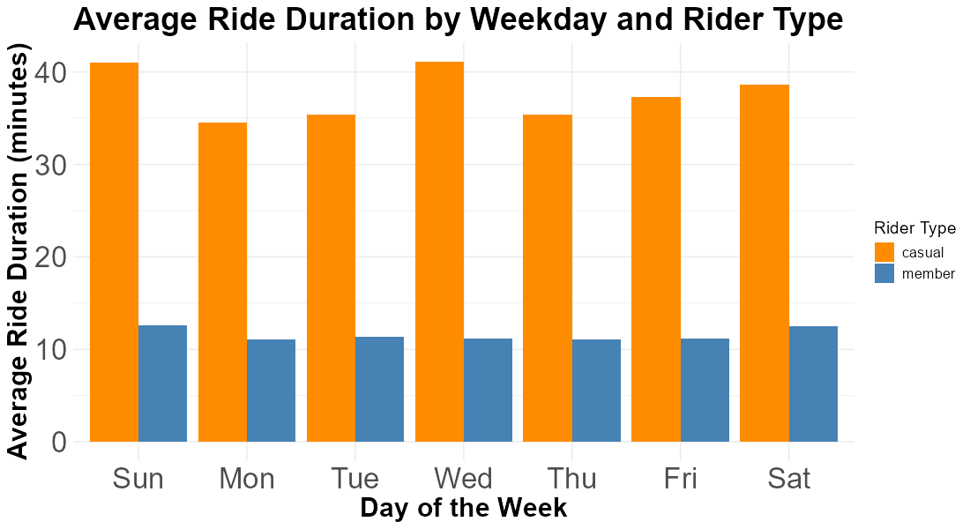
Consistently Longer Rides, Especially on Weekends
Casual usage spikes on weekends
Indicates leisure behavior, not commuting
Test time-sensitive offers when casuals are most active
Notes:
“This chart shows average ride duration by weekday, comparing casual and member users.
Casual riders consistently ride longer than members, across every single day. But the gap gets even wider on weekends.
This strongly suggests that casual riders use the service for leisure, especially on Saturdays and Sundays.
That’s important for two reasons: First, it explains why casuals often go beyond the 45-minute threshold and incur higher costs. Second, it gives us a timing signal: weekends are when casual riders are most active and most vulnerable to overspending.
That’s where targeted messaging or promotional nudges would be most effective, for example, trial memberships or upgrade prompts shown at booking time on weekends.”

Slide 11
Strategic Takeaways
High-value casual riders (those riding over 45 mins) represent 21% of all casual trips
These riders are already overspending compared to the cost of membership
Behavior patterns show they are most active on weekends → leisure-driven use
Cyclistic can convert this segment with targeted, time-sensitive offers
This shift would reduce customer cost and stabilize long-term revenue for the company
Notes:
“To close, here are the key insights we uncovered.
We’ve identified a segment of casual users whose behavior and spending patterns clearly align with the benefits of membership.
They’re riding longer, often paying more, and doing so most often on weekends — when targeted messaging could be most effective.
Converting this group would benefit both the user and the business.
It’s not just a data opportunity — it’s a strategic one.”

Slide 12
Turn Insight Into Action
Launch weekend-focused trial campaigns for casual riders
Offer time-limited discounts to casuals with high per-ride spend
Promote flat-rate savings in-app at point of purchase
Add incentives for long-ride casuals to join within 24 hours
Notes:
“To translate these insights into action, we propose four tactical moves.
First, we target weekends, the time of peak casual usage, with trial offers that let riders experience membership benefits risk-free.
Second, offer dynamic discounts to riders whose spend per ride suggests they'd save as members.
Third, present flat-rate savings directly in the app, right when they’re about to pay, so the value is clear.
Finally, use post-ride triggers: after a long or costly ride, nudge them to join within 24 hours with a special incentive.
These tactics are data-driven, time-sensitive, and require minimal engineering to test.”

Slide 13
APPENDIX

Slide 14
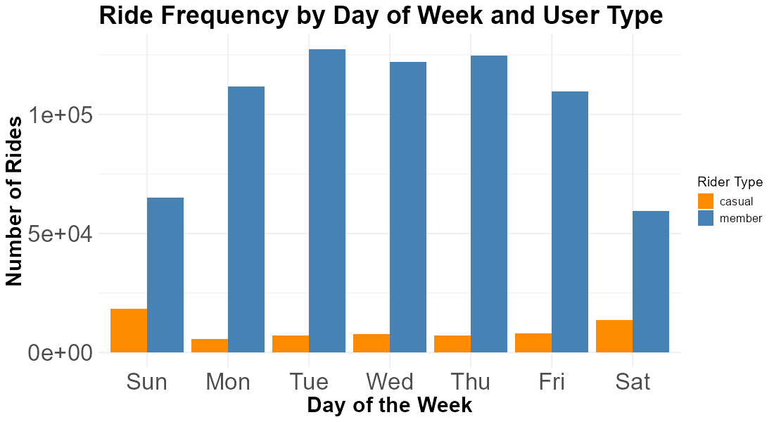
Weekends Are Key to Reaching Casual Riders
Casual usage spikes on weekends
Indicates leisure-oriented, non-commuter behavior
Ideal timing to target with conversion offers
Notes:
This chart shows that while members ride consistently throughout the week, casual riders are most active on weekends.
This tells us that casuals treat cycling as a leisure activity, not daily transport.
It’s a behavioral insight we can leverage: to boost conversions, we should design promotions and communications that target these weekend riders when they’re most engaged.

